Slide 1
Chapter 5: Semantic Memory

Slide 2
What is Semantic Memory?
General knowledge of the world
  Separate system from episodic memory
  Not temporal!
Lexical memory: Mental dictionary
  Separate (but related) to semantic memory
Notes:
Semantic memory: The neurocognitive memory system that encodes, stores, and retrieves information concerning knowledge of the world.
It is supported by a separate neurocognitive system, unlike episodic memory that has a temporal dynamic.
Lexical memory (lexicon): Our mental dictionary; a representational system for the words of our language.
It is a separate neurocognitive system from semantic (and episodic memory).
Despite overlaps between semantic and lexical memories, the former is studied by researchers interested in memory, while the latter by those interested in language.
Psycholinguists are interested in the structure of the representational system involved in lexical memory as it seems to maintain a huge number of items, access to which is extremely fast.
The encoding of words into lexical memory is also of great interest.

Slide 3
What is Semantic Memory?
Two different approaches to Semantics:
  Memory researchers: How is meaning represented as memory
  Psycholinguists: How is meaning represented via language?
Notes:
Semantic memory: The neurocognitive memory system that encodes, stores, and retrieves information concerning knowledge of the world.
It is supported by a separate neurocognitive system, unlike episodic memory that has a temporal dynamic.
Lexical memory (lexicon): Our mental dictionary; a representational system for the words of our language.
It is a separate neurocognitive system from semantic (and episodic memory).
Despite overlaps between semantic and lexical memories, the former is studied by researchers interested in memory, while the latter by those interested in language.
Psycholinguists are interested in the structure of the representational system involved in lexical memory as it seems to maintain a huge number of items, access to which is extremely fast.
The encoding of words into lexical memory is also of great interest.

Slide 4
Associative Structures in Semantic Memory
Associative model: Representing information in terms of connections
Spreading activation: Activating one concept activates similar concepts in the network
Hierarchical network model: Knowledge organized by levels (Collins & Quillian, 1969)
Notes:
Satisfies Learning Objective 1: Describe the associative nature of semantic memory.
Associative model: Representation of information in semantic memory in terms of connections among units of information.
A node is the unit of memory, which is then connected to other nodes.
Spreading activation: Refers to the transfer of activation from one node to an associated node.
Activation weakens as it spreads from node to node.
Hierarchical network model: A model in which semantic memory is organized by levels or hierarchies in which particular nodes are associated with characteristics associated with that level, but not with higher or lower levels.
Developed by Collins and Quillian.
The model was elaborated upon by Collins and Loftus with the spreading activation model that focuses on the idea of a web of connections among nodes (or concepts) within the model.

Slide 5
Describing Meaning (2 of 2)
Free Associations: Likelihood that cue word elicits target as a response
Can tell us about how concepts are stored in memory

Slide 6
Example Free Association Task
What’s the first word that comes to mind for the following?

Slide 7
Example Free Association Task
CAT

Slide 8
Example Free Association Task
MOUSE

Slide 9
Example Free Association Task
CHAIR

Slide 10
Example Free Association Task
HAPPY

Slide 12
Common Associates
CAT – DOG (.513)
MOUSE – CAT (.543)
CHAIR – TABLE (.314)
HAPPY – SAD (.628)

Slide 13
Associative Memory Structure
Dog
House
Mouse
Cat
Cheese
Notes:
Satisfies Learning Objective 1: Describe the associative nature of semantic memory.
Associative model: Representation of information in semantic memory in terms of connections among units of information.
A node is the unit of memory, which is then connected to other nodes.
Spreading activation: Refers to the transfer of activation from one node to an associated node.
Activation weakens as it spreads from node to node.
Hierarchical network model: A model in which semantic memory is organized by levels or hierarchies in which particular nodes are associated with characteristics associated with that level, but not with higher or lower levels.
Developed by Collins and Quillian.
The model was elaborated upon by Collins and Loftus with the spreading activation model that focuses on the idea of a web of connections among nodes (or concepts) within the model.

Slide 14
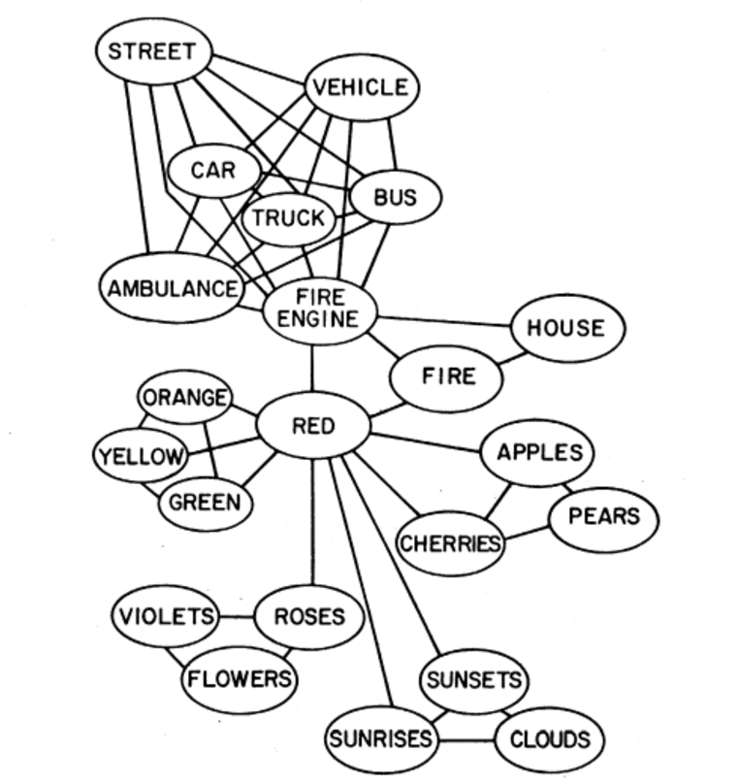

Slide 15
Types of Associations
Associations capture a wide variety of meaning!
  Lexical: Mail – Box
  Semantic: Dog – Bark
  Mediated: Lion – Stripes

Slide 16
Semantic Features
Defining an object in terms of its constituent parts
What features are most important?

Slide 17
Semantic Features
TABLE

Slide 18
Semantic Features
CAR

Slide 19
Semantic Features
PHONE

Slide 20
Semantic Priming (1 of 2)
Priming: Effect of one word or idea on the processing of a related word or idea
Semantic Priming: A related word activate a target and allow it be processed more quickly
Spreading Activation!
Notes:
Satisfies Learning Objective 1: Describe the associative nature of semantic memory.
Semantic priming: The effect of one word or idea on the processing of a related word or idea.
A related word will activate a target item and allow it to be processed more quickly.
Lexical decision task: A cognitive task in which participants judge whether a string of letters is a word as quickly as they can.
Semantic priming can be added to a lexical decision task.
Primes may be related or unrelated to the to-be-judged words.
Characteristic features:
Priming crosses languages, as demonstrated by Poort et al. in their study on how priming with sentences in Dutch was sufficient to prime words in a lexical decision task in English.
Priming is also a marker of certain neurological impairments, as demonstrated by Howells and Cardell in the comparative study of patients with anomic aphasia.
Mediated priming:
Occurs when the prime word is related to a word, which is also related to the target word.
Duñabeitia et al. showed that mediated priming could also cross over from semantic characteristics to phonological characteristics.

Slide 21
Semantic Priming (2 of 2)
How to test for semantic priming?
Notes:
Satisfies Learning Objective 1: Describe the associative nature of semantic memory.
Semantic priming: The effect of one word or idea on the processing of a related word or idea.
A related word will activate a target item and allow it to be processed more quickly.
Lexical decision task: A cognitive task in which participants judge whether a string of letters is a word as quickly as they can.
Semantic priming can be added to a lexical decision task.
Primes may be related or unrelated to the to-be-judged words.
Characteristic features:
Priming crosses languages, as demonstrated by Poort et al. in their study on how priming with sentences in Dutch was sufficient to prime words in a lexical decision task in English.
Priming is also a marker of certain neurological impairments, as demonstrated by Howells and Cardell in the comparative study of patients with anomic aphasia.
Mediated priming:
Occurs when the prime word is related to a word, which is also related to the target word.
Duñabeitia et al. showed that mediated priming could also cross over from semantic characteristics to phonological characteristics.

Slide 22
Lexical Decision Tasks
Lexical Decision Task (LDT): Judging a string of letters as a word.
Example: https://www.psytoolkit.org/experiment-library/ldt.html
Notes:
Satisfies Learning Objective 1: Describe the associative nature of semantic memory.
Semantic priming: The effect of one word or idea on the processing of a related word or idea.
A related word will activate a target item and allow it to be processed more quickly.
Lexical decision task: A cognitive task in which participants judge whether a string of letters is a word as quickly as they can.
Semantic priming can be added to a lexical decision task.
Primes may be related or unrelated to the to-be-judged words.
Characteristic features:
Priming crosses languages, as demonstrated by Poort et al. in their study on how priming with sentences in Dutch was sufficient to prime words in a lexical decision task in English.
Priming is also a marker of certain neurological impairments, as demonstrated by Howells and Cardell in the comparative study of patients with anomic aphasia.
Mediated priming:
Occurs when the prime word is related to a word, which is also related to the target word.
Duñabeitia et al. showed that mediated priming could also cross over from semantic characteristics to phonological characteristics.

Slide 23
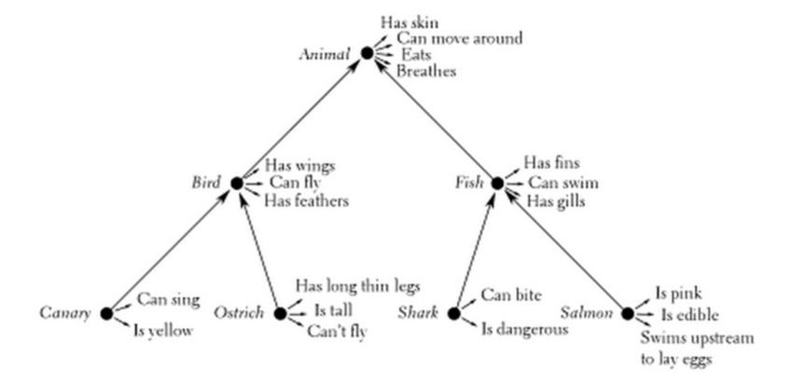
Associative Memory Structure
Notes:
Satisfies Learning Objective 1: Describe the associative nature of semantic memory.
Associative model: Representation of information in semantic memory in terms of connections among units of information.
A node is the unit of memory, which is then connected to other nodes.
Spreading activation: Refers to the transfer of activation from one node to an associated node.
Activation weakens as it spreads from node to node.
Hierarchical network model: A model in which semantic memory is organized by levels or hierarchies in which particular nodes are associated with characteristics associated with that level, but not with higher or lower levels.
Developed by Collins and Quillian.
The model was elaborated upon by Collins and Loftus with the spreading activation model that focuses on the idea of a web of connections among nodes (or concepts) within the model.

Slide 24
Sentence Verification Tasks (1 of 2)
Quickly deciding whether a statement about a concept is true or false
Example: “A cat is an animal” or “a dog is a plant”
Predictions?
Notes:
Satisfies Learning Objective 1: Describe the associative nature of semantic memory.
Sentence verification task: Participants are asked to decide as quickly as possible if a sentence is true or false.
Arguments by Collins and Quillian:
Characteristics, unique to a particular item, will be closely linked in associative space.
Characteristics, shared with other items, will be more distantly linked.
Closer associations lead to faster verification times.
Evidence from neuroimaging data:
Neuroimaging employing sentence-verification tasks supports the existence of associative networks.
Raposo et al. studied participants through semantic verification tasks while they were being scanned by fMRI technology.
Associative network:
Based on the findings by Raposo et al., it can be concluded that semantic memory is organized into an associative network.
In such a network, information is linked with varying strengths and at varying distances.

Slide 25
Sentence Verification Example
A canary is yellow
Fish have wings
A canary has skin
Notes:
Satisfies Learning Objective 1: Describe the associative nature of semantic memory.
Sentence verification task: Participants are asked to decide as quickly as possible if a sentence is true or false.
Arguments by Collins and Quillian:
Characteristics, unique to a particular item, will be closely linked in associative space.
Characteristics, shared with other items, will be more distantly linked.
Closer associations lead to faster verification times.
Evidence from neuroimaging data:
Neuroimaging employing sentence-verification tasks supports the existence of associative networks.
Raposo et al. studied participants through semantic verification tasks while they were being scanned by fMRI technology.
Associative network:
Based on the findings by Raposo et al., it can be concluded that semantic memory is organized into an associative network.
In such a network, information is linked with varying strengths and at varying distances.

Slide 26
Associative Memory Structure
A canary is yellow vs A canary has skin
Notes:
Satisfies Learning Objective 1: Describe the associative nature of semantic memory.
Associative model: Representation of information in semantic memory in terms of connections among units of information.
A node is the unit of memory, which is then connected to other nodes.
Spreading activation: Refers to the transfer of activation from one node to an associated node.
Activation weakens as it spreads from node to node.
Hierarchical network model: A model in which semantic memory is organized by levels or hierarchies in which particular nodes are associated with characteristics associated with that level, but not with higher or lower levels.
Developed by Collins and Quillian.
The model was elaborated upon by Collins and Loftus with the spreading activation model that focuses on the idea of a web of connections among nodes (or concepts) within the model.

Slide 27
Sentence Verification Tasks (2 of 2)
Quick decision of true or false.
  Close associations (in the network) are faster to verify
  Suggests that concept information is organized hierarchically
Notes:
Satisfies Learning Objective 1: Describe the associative nature of semantic memory.
Sentence verification task: Participants are asked to decide as quickly as possible if a sentence is true or false.
Arguments by Collins and Quillian:
Characteristics, unique to a particular item, will be closely linked in associative space.
Characteristics, shared with other items, will be more distantly linked.
Closer associations lead to faster verification times.
Evidence from neuroimaging data:
Neuroimaging employing sentence-verification tasks supports the existence of associative networks.
Raposo et al. studied participants through semantic verification tasks while they were being scanned by fMRI technology.
Associative network:
Based on the findings by Raposo et al., it can be concluded that semantic memory is organized into an associative network.
In such a network, information is linked with varying strengths and at varying distances.

Slide 28
Bilingual Representation
Single-store view of bilingual representation.
Dual-store view (or separate store) of bilingual representation.
Cross-language semantic priming.
  Suggests a single store view
Notes:
Satisfies Learning Objective 1: Describe the associative nature of semantic memory.
Single-store view of bilingual representation: There is a common semantic level of representation in bilinguals.
Dual-store view (or separate store) of bilingual representation: Meaning is represented separately for each language in the lexical memory of a bilingual.
Cross-language semantic priming: The effect of priming a word in one language has on a related word in another language in bilinguals or multilinguals.

Slide 29
Concepts and Categories
Concept: Mental construct associated w/ a specific idea
Category: Groups of constructs
Both are stored in semantic memory!
Notes:
Satisfies Learning Objective 2: Demonstrate an understanding of concepts, categories, and theories of their representation.
Concept: Mental construct that contains information associated with a specific idea.
Category: Mental construct referring to a set of objects or ideas that are grouped together or are associated with each other.
Differences between the two:
Concept can be a mental representations of categories and is a broader term than category.
Categories are more concrete.
Both are stored in the semantic memory.
Complexity of concepts:
Because of complexity, cognitive neuroscientists expect the representation of concepts to be widely distributed throughout the brain.
This is borne out in the analyses carried out by Kuchinke et al.

Slide 30
Concepts and Categories (1 of 5)
Categories Are Fuzzy
No clear boundaries
Boundary conditions: How do we define category members?
Notes:
Satisfies Learning Objective 2: Demonstrate an understanding of concepts, categories, and theories of their representation.
Fuzzy boundaries: Categories, despite their apparent concreteness, have fuzzy boundaries.
Boundary conditions: These are important in defining categories.
Researchers think of categories as complex and related to each other in multiple ways because of these boundary conditions.
Levels of categorization: Categories are nested structures in which the level of organization is important in defining the category.
There are three such levels: Basic, subordinate, and superordinate:
The basic level is the one we are most likely to invoke.
The subordinate level allows for more specific or specialized categories to be formed.
Superordinate categories are higher order categories that include general information and many more common categories.
These levels are fluid.
Basic-level information is retrieved faster than subordinate or superordinate information.
Different levels are associated with different areas of the brain, as examined and demonstrated by Kosslyn et al. who used positron emission tomography (PET) technology to examine categorization.

Slide 31
Defining Concepts
How would you define…
Birds
Notes:
Take a sheet of paper. Draw a bird!

Slide 32

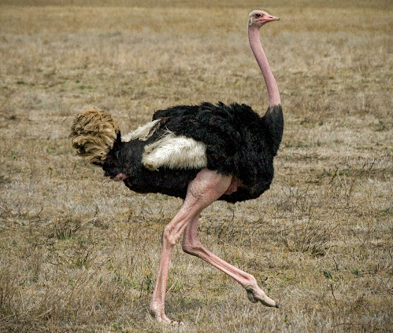

Birds…
Notes:
Satisfies Learning Objective 2: Demonstrate an understanding of concepts, categories, and theories of their representation.
Fuzzy boundaries: Categories, despite their apparent concreteness, have fuzzy boundaries.
Boundary conditions: These are important in defining categories.
Researchers think of categories as complex and related to each other in multiple ways because of these boundary conditions.
Levels of categorization: Categories are nested structures in which the level of organization is important in defining the category.
There are three such levels: Basic, subordinate, and superordinate:
The basic level is the one we are most likely to invoke.
The subordinate level allows for more specific or specialized categories to be formed.
Superordinate categories are higher order categories that include general information and many more common categories.
These levels are fluid.
Basic-level information is retrieved faster than subordinate or superordinate information.
Different levels are associated with different areas of the brain, as examined and demonstrated by Kosslyn et al. who used positron emission tomography (PET) technology to examine categorization.

Slide 33
Concepts and Categories (1 of 5)
Levels of categorization:
  Basic level: One we are most likely to use
  Subordinate: Specific/specialized
  Superordinate: Higher order, more general info
Notes:
Satisfies Learning Objective 2: Demonstrate an understanding of concepts, categories, and theories of their representation.
Fuzzy boundaries: Categories, despite their apparent concreteness, have fuzzy boundaries.
Boundary conditions: These are important in defining categories.
Researchers think of categories as complex and related to each other in multiple ways because of these boundary conditions.
Levels of categorization: Categories are nested structures in which the level of organization is important in defining the category.
There are three such levels: Basic, subordinate, and superordinate:
The basic level is the one we are most likely to invoke.
The subordinate level allows for more specific or specialized categories to be formed.
Superordinate categories are higher order categories that include general information and many more common categories.
These levels are fluid.
Basic-level information is retrieved faster than subordinate or superordinate information.
Different levels are associated with different areas of the brain, as examined and demonstrated by Kosslyn et al. who used positron emission tomography (PET) technology to examine categorization.

Slide 34
Concepts and Categories (2 of 5)
Animals
Superordinate
Birds
Basic
Specific Types of Birds
Subordinate
Notes:
Satisfies Learning Objective 2: Demonstrate an understanding of concepts, categories, and theories of their representation.
Fuzzy boundaries: Categories, despite their apparent concreteness, have fuzzy boundaries.
Boundary conditions: These are important in defining categories.
Researchers think of categories as complex and related to each other in multiple ways because of these boundary conditions.
Levels of categorization: Categories are nested structures in which the level of organization is important in defining the category.
There are three such levels: Basic, subordinate, and superordinate:
The basic level is the one we are most likely to invoke.
The subordinate level allows for more specific or specialized categories to be formed.
Superordinate categories are higher order categories that include general information and many more common categories.
These levels are fluid.
Basic-level information is retrieved faster than subordinate or superordinate information.
Different levels are associated with different areas of the brain, as examined and demonstrated by Kosslyn et al. who used positron emission tomography (PET) technology to examine categorization.

Slide 35
Concepts and Categories (3 of 5)
Family Resemblance: Membership in a category is based on similarity to other members
Ambiguity of categories: Depends on the viewpoint of the person conceptualizing them!
Notes:
Satisfies Learning Objective 2: Demonstrate an understanding of concepts, categories, and theories of their representation.
Family resemblance: Membership in a category may be defined by each item’s general similarity to other members in the category rather than by a specific list of features.
Many categories are multimodal and with many applicable characteristics.
Ambiguity of categories: Categories depend on the viewpoint of the person conceptualizing them.

Slide 36
Concepts and Categories (4 of 5)
Exemplar Theory: Categories have large numbers of specific instances
Example: Each time you encounter a specific type of bird
Potential problem?
Criticism: Requires lots of memory!
Notes:
Satisfies Learning Objective 2: Demonstrate an understanding of concepts, categories, and theories of their representation.
Exemplar theory: Categories are classified by maintaining a large number of specific instances of a category (exemplars) that are associated with each other in semantic memory.
It is distinct from prototype theory.
It accounts for the multidimensional nature of a category.
Priming can be specific to the particular aspect of the exemplar that is being primed.
Criticism of the theory centers on its premise that it necessitates a large memory system that can store large numbers of exemplars for different categories.
This criticism has been countered with the fact the seemingly limitless capacity of long-term memory to store information.
Feature comparison theory: We define our categories by maintaining a list of features for any particular category.
New objects are matched to the list of features and categorized accordingly.
Defining features: According to feature comparison theory, defining features are required for any example of a particular category.
Characteristic features: According to feature comparison theory, characteristic features generally accompany an instance of the category but are not required.
Criticism of feature comparison:
This is an essentially flawed theory because few categories have clear defining features.
As a result, the prototype theory is considered a better choice for explaining the structure of semantic memory.

Slide 37
Concepts and Categories (5 of 5)
Prototype Theory: Categories center around the single most representative member
Prototype doesn’t need to be a real category member
Example: Canaries vs. Ostriches vs. Penguins
Notes:
Satisfies Learning Objective 2: Demonstrate an understanding of concepts, categories, and theories of their representation.
Prototype theory: States that prototypes form the central characteristic in our representation of categories.
A prototype is defined as the most typical member of a particular category.
The prototype itself need not be a real member of the category.
Evidence for the theory:
Prototypes are easily named as demonstrated in studies by Eleanor Rosch and her colleagues.
Prototypes and semantic priming: Semantic priming works better if the target words are prototypical rather than nonprototypical.

Slide 38
Schemas and Scripts (1 of 3)
Schema: Generalized knowledge
Scripts: Sequence of events.
Brewer and Treyens (1981)
  More expected items remembered at a greater rate
Notes:
Satisfies Learning Objective 3: Explain schemas and scripts and their role in semantic memory.
Schema: Generalized knowledge about an event, a person, or a situation.
They are patterns of connected information about a particular topic.
Schemas and scripts are well-learned patterns that guide our behavior and organize information in memory.
Scripts: Well-learned sequences of events associated with common activities.
Study by Brewer and Treyens:
Participants were asked to wait in a lab room for a short time before entering another room for testing, where they were asked to recall all of the objects that they could remember from the waiting room.
From their observations, the researchers concluded that schema-consistent items are well remembered.
Schema-violating items are also well remembered.
Schema-irrelevant items are less well remembered.

Slide 39
Schemas and Scripts (2 of 3)
Stereotypes: Schemas for semantic representations of people
Provide a mental shortcut
Problems?
Potently lead to false memory for something that is stereotype-consistent but not true
Notes:
Satisfies Learning Objective 3: Explain schemas and scripts and their role in semantic memory.
Role of stereotypes:
Stereotypes function as schemas for our semantic memory representations of people.
They promote the encoding of stereotype-consistent information and can lead us to falsely remember something that is stereotype-consistent but not actually true.
Role of schemas in encoding: The schema forms the backbone upon which new information can be associated, as was demonstrated in a study by Bransford and Johnson.
Counterproductive schemas:
This was illustrated by Badham and Maylor in a study where asked participants to learn weakly related word pairs.
In one condition, participants were given a schema that helped them organize the items.
In other conditions, participants relied on their own idiosyncratic encoding techniques.
The performance in the schema condition was lower, suggesting that provision of schema-type information led participants to use less than optimal encoding techniques.

Slide 40
Schemas and Scripts (3 of 3)
Reconstruction of Events
Retrieving longer events and information.
Changes overtime! Experimental study by Bartlett.
Notes:
Satisfies Learning Objective 3: Explain schemas and scripts and their role in semantic memory.
Retrieving longer events and information: Schemas provide structure for retrieving longer events and information.
Experimental study by Bartlett:
Premised on the use of schemas in storytelling.
Students were asked to play a “telephone game” in which students had to pass on a native American folktale, “War of the Ghosts.”
The final student had to write the story down.
The final version had changes from the original in accordance with the schema for a story from someone from British culture.

Slide 41
Representation and Imagery (1 of 3)
Representation: Storage of information in memory when not in use
  Activating == creating a mental image
Problem of studying representation?
  Can’t be directly studied; must be inferred
Notes:
Satisfies Learning Objective 4: Interpret the nature of visual representation in semantic memory.
Representation: The storage of information in memory when that information is not in use.
1. Activating visual information means creating a visual image.
Debate in visual imagery: Debate surrounds the question as to how we code the images we store and remember, at both cognitive and neural levels.
Problem of studying representation:
It is not possible to directly examine mental images or their stored representations.
Cognitive psychologists must infer what mental representations are like based on visible behaviors or reports of the person doing the imaging.
Analog representation and propositional representation:
Analog representation: The theory that we store visual images in a manner similar to actual pictures.
Propositional representation: The theory that we store visual images in terms of a language-like code.
Back in the 1960s, the propositional view was taken to be the correct one by most researchers as they argued that analog visual memory would take up huge amounts of memory within the brain.
On the other hand, storing information in a descriptive text-like representation requires much less memory.
Most researchers are now convinced by the vast amount of empirical data that support the analog view.
One of the most famous studies in psychology to support this view is the Shepard and Metzler’s (1971) mental rotation experiment:
An experiment on visual imagery that showed that representation is analog.

Slide 42
Representation and Imagery (2 of 3)
Analog representation vs propositional representation.
  Are mental images stored like actual pictures or in a language-like code?
Analog: We store visual images similar to actual pictures
Propositional: Images are stored using a language like code
Notes:
Satisfies Learning Objective 4: Interpret the nature of visual representation in semantic memory.
Representation: The storage of information in memory when that information is not in use.
1. Activating visual information means creating a visual image.
Debate in visual imagery: Debate surrounds the question as to how we code the images we store and remember, at both cognitive and neural levels.
Problem of studying representation:
It is not possible to directly examine mental images or their stored representations.
Cognitive psychologists must infer what mental representations are like based on visible behaviors or reports of the person doing the imaging.
Analog representation and propositional representation:
Analog representation: The theory that we store visual images in a manner similar to actual pictures.
Propositional representation: The theory that we store visual images in terms of a language-like code.
Back in the 1960s, the propositional view was taken to be the correct one by most researchers as they argued that analog visual memory would take up huge amounts of memory within the brain.
On the other hand, storing information in a descriptive text-like representation requires much less memory.
Most researchers are now convinced by the vast amount of empirical data that support the analog view.
One of the most famous studies in psychology to support this view is the Shepard and Metzler’s (1971) mental rotation experiment:
An experiment on visual imagery that showed that representation is analog.

Slide 43
Analog vs Propositional
Analog visual memory would require a lot of memory capacity
1960’s: Researchers assumed that propositional view was correct
Today: Most research supports the analog view
Notes:
Satisfies Learning Objective 4: Interpret the nature of visual representation in semantic memory.
Representation: The storage of information in memory when that information is not in use.
1. Activating visual information means creating a visual image.
Debate in visual imagery: Debate surrounds the question as to how we code the images we store and remember, at both cognitive and neural levels.
Problem of studying representation:
It is not possible to directly examine mental images or their stored representations.
Cognitive psychologists must infer what mental representations are like based on visible behaviors or reports of the person doing the imaging.
Analog representation and propositional representation:
Analog representation: The theory that we store visual images in a manner similar to actual pictures.
Propositional representation: The theory that we store visual images in terms of a language-like code.
Back in the 1960s, the propositional view was taken to be the correct one by most researchers as they argued that analog visual memory would take up huge amounts of memory within the brain.
On the other hand, storing information in a descriptive text-like representation requires much less memory.
Most researchers are now convinced by the vast amount of empirical data that support the analog view.
One of the most famous studies in psychology to support this view is the Shepard and Metzler’s (1971) mental rotation experiment:
An experiment on visual imagery that showed that representation is analog.

Slide 44
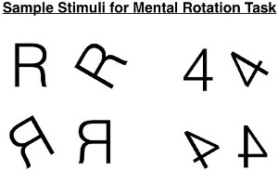
Representation and Imagery (3 of 3)
Shepard and Metzler’s Mental Rotation Experiment
Participants viewed shapes. Asked to “mentally rotate” them
Notes:
Satisfies Learning Objective 4: Interpret the nature of visual representation in semantic memory.
Imagery: The experience of retrieving a memory that is mostly visual or experienced primarily as a sensory experience.
Imagery can also refer to the representation of those memories.
The experimental study:
Shepard and Metzler wanted to show that mental images behave like real pictures.
Participants were asked to mentally rotate objects that were shown to them in pictures.
Empirically, the researchers wished to learn if the participants take longer to mentally rotate a figure more.
They measured the amount of time it took participants to come to a decision of same versus different as a function of the degrees of difference between the two figures in a pair.
The experiment showed a clear linear relation between the degrees of difference between the two figures in a pair and how long the decision took.
The Shepard and Metzler data support the analog view.
Other research studies:
Lee Brooks conducted an experimental study whose results also support the analog view.
A study by prominent researcher, Stephen Kosslyn, also supported this view.
In another study by Kosslyn et al., it was successfully established how mental imagery followed the same principles as real-world imagery.
Criticisms:
Proponents of the propositional view have criticized the data from experiments supporting the analog view.
Visual imagery is not needed, instead mental propositions or sentences can account for much of the data.
Pylyshyn’s version of the propositional view, images are represented as abstract, language-like descriptions, instead of pictures.
This model, thus, views the visual image as a by-product of a retrieval process and not the result of encoding and storage.

Slide 45
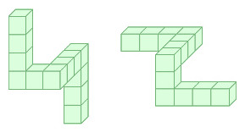
Mental Rotation Example (1)
Notes:
Satisfies Learning Objective 4: Interpret the nature of visual representation in semantic memory.
Imagery: The experience of retrieving a memory that is mostly visual or experienced primarily as a sensory experience.
Imagery can also refer to the representation of those memories.
The experimental study:
Shepard and Metzler wanted to show that mental images behave like real pictures.
Participants were asked to mentally rotate objects that were shown to them in pictures.
Empirically, the researchers wished to learn if the participants take longer to mentally rotate a figure more.
They measured the amount of time it took participants to come to a decision of same versus different as a function of the degrees of difference between the two figures in a pair.
The experiment showed a clear linear relation between the degrees of difference between the two figures in a pair and how long the decision took.
The Shepard and Metzler data support the analog view.
Other research studies:
Lee Brooks conducted an experimental study whose results also support the analog view.
A study by prominent researcher, Stephen Kosslyn, also supported this view.
In another study by Kosslyn et al., it was successfully established how mental imagery followed the same principles as real-world imagery.
Criticisms:
Proponents of the propositional view have criticized the data from experiments supporting the analog view.
Visual imagery is not needed, instead mental propositions or sentences can account for much of the data.
Pylyshyn’s version of the propositional view, images are represented as abstract, language-like descriptions, instead of pictures.
This model, thus, views the visual image as a by-product of a retrieval process and not the result of encoding and storage.

Slide 46
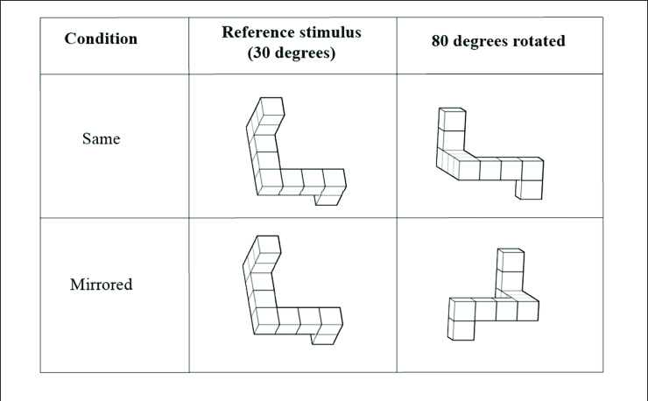
Mental Rotation Example (2)
Notes:
Satisfies Learning Objective 4: Interpret the nature of visual representation in semantic memory.
Imagery: The experience of retrieving a memory that is mostly visual or experienced primarily as a sensory experience.
Imagery can also refer to the representation of those memories.
The experimental study:
Shepard and Metzler wanted to show that mental images behave like real pictures.
Participants were asked to mentally rotate objects that were shown to them in pictures.
Empirically, the researchers wished to learn if the participants take longer to mentally rotate a figure more.
They measured the amount of time it took participants to come to a decision of same versus different as a function of the degrees of difference between the two figures in a pair.
The experiment showed a clear linear relation between the degrees of difference between the two figures in a pair and how long the decision took.
The Shepard and Metzler data support the analog view.
Other research studies:
Lee Brooks conducted an experimental study whose results also support the analog view.
A study by prominent researcher, Stephen Kosslyn, also supported this view.
In another study by Kosslyn et al., it was successfully established how mental imagery followed the same principles as real-world imagery.
Criticisms:
Proponents of the propositional view have criticized the data from experiments supporting the analog view.
Visual imagery is not needed, instead mental propositions or sentences can account for much of the data.
Pylyshyn’s version of the propositional view, images are represented as abstract, language-like descriptions, instead of pictures.
This model, thus, views the visual image as a by-product of a retrieval process and not the result of encoding and storage.

Slide 47
Representation and Imagery (2 of 2)
Shepard and Metzler’s Mental Rotation Experiment
Participants viewed shapes. Asked to “mentally rotate” them
Research question: Do more complicated images take longer to rotate?
Finding: Clear relationship between difficulty and time; supports analogue model
Notes:
Satisfies Learning Objective 4: Interpret the nature of visual representation in semantic memory.
Imagery: The experience of retrieving a memory that is mostly visual or experienced primarily as a sensory experience.
Imagery can also refer to the representation of those memories.
The experimental study:
Shepard and Metzler wanted to show that mental images behave like real pictures.
Participants were asked to mentally rotate objects that were shown to them in pictures.
Empirically, the researchers wished to learn if the participants take longer to mentally rotate a figure more.
They measured the amount of time it took participants to come to a decision of same versus different as a function of the degrees of difference between the two figures in a pair.
The experiment showed a clear linear relation between the degrees of difference between the two figures in a pair and how long the decision took.
The Shepard and Metzler data support the analog view.
Other research studies:
Lee Brooks conducted an experimental study whose results also support the analog view.
A study by prominent researcher, Stephen Kosslyn, also supported this view.
In another study by Kosslyn et al., it was successfully established how mental imagery followed the same principles as real-world imagery.
Criticisms:
Proponents of the propositional view have criticized the data from experiments supporting the analog view.
Visual imagery is not needed, instead mental propositions or sentences can account for much of the data.
Pylyshyn’s version of the propositional view, images are represented as abstract, language-like descriptions, instead of pictures.
This model, thus, views the visual image as a by-product of a retrieval process and not the result of encoding and storage.

Slide 48
Cognitive Maps
Mental representation of external world.
Studies by Friedman et al.
  American and Canadian College students looked at maps of California and Alberta. Some maps had city names, others just had dots
  Asked to judge distance between cities based on their own cognitive maps
  Estimates were more accurate for those who only had dots
Notes:
Satisfies Learning Objective 4: Interpret the nature of visual representation in semantic memory.
Cognitive maps: Mental representations of the external world based on our spatial representation of the world.
These maps usually refer to the familiar environments we inhabit.
Semantic categories: Meaning affects our cognitive maps.
For example, people tend to think of borders between countries as being straighter than they often are.
These categories may often lead to inaccuracies.
Studies by Friedman et al.:
In their experiment, American and Canadian college students were asked to examine maps of California and Alberta, marked with only dots and not with city names or marked with dots and the corresponding city names.
Based on their examination, students were asked to judge the distance between various dots based on their cognitive maps.
The conclusions revealed that the distance estimates were more accurate for those participants who had not had the names supplied originally.
The researchers concluded that their experimental results illustrate the idea that category information is used when making cognitive maps.

